Slide 1
Mandarin
2月3号

Slide 2
万事如意
A useful wish to wish people on special occasions, such as 春节

Slide 3
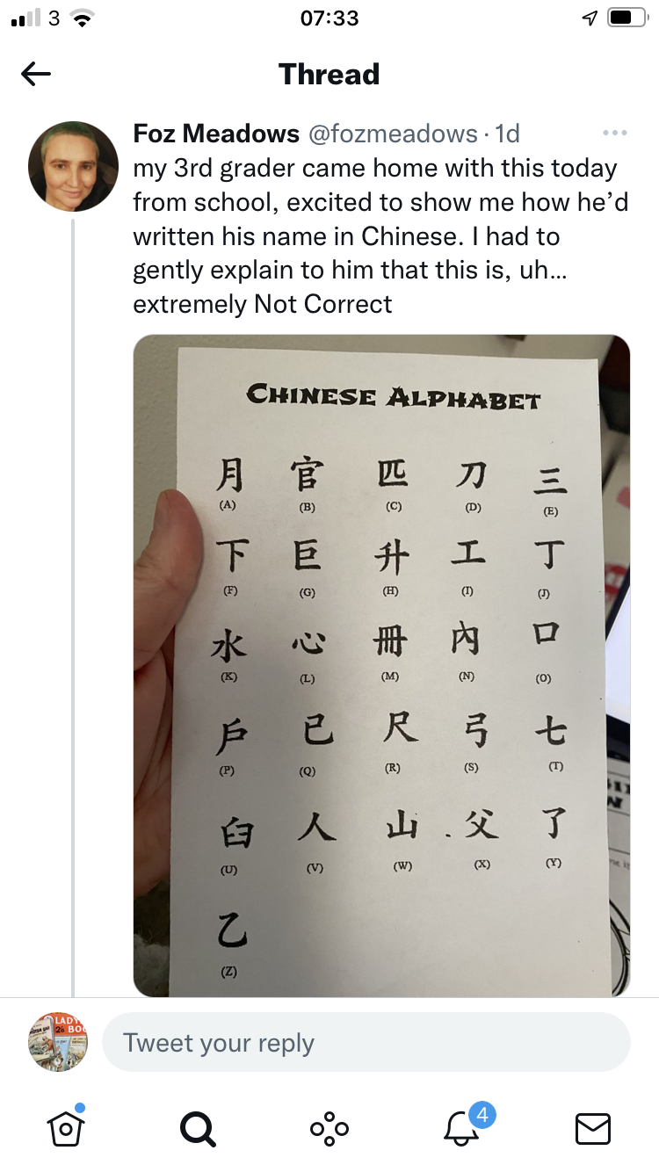

Slide 4
Write the pinyin
I introduce you 我介绍
I see you 我看你
I invite you 我请你
I tell you 我告诉你
I say to you 我对你说
I give you 我送给你
I make you 我让你

Slide 5
唱歌 面包 会说 那些
大学 去年 上学 外国
电脑 汉语 上网 下午
电话 电视 饭店 见面
Chànggē miànbāo huì shuō nàxiē
dàxué qùnián shàngxué wàiguó
diànnǎo hànyǔ shàngwǎng xiàwǔ
diànhuà diànshì fàndiàn jiànmiàn
4th tone combinations:
https://youtu.be/WFcNEyC98nw

Slide 6
让我们复习一下 （Revision corner)
The seasons
Radicals
Writing a sentence – I’m not Chinese. I’m British. I live in Britain. My Chinese is not so good. My friend speaks Chinese very well. Next year he wants to go travelling in Britain. He would like to visit London Library. He really likes travelling by train.
Speaking: sentence patterns https://www.youtube.com/watch?v=Zrj1yyjEnrQ

Slide 7
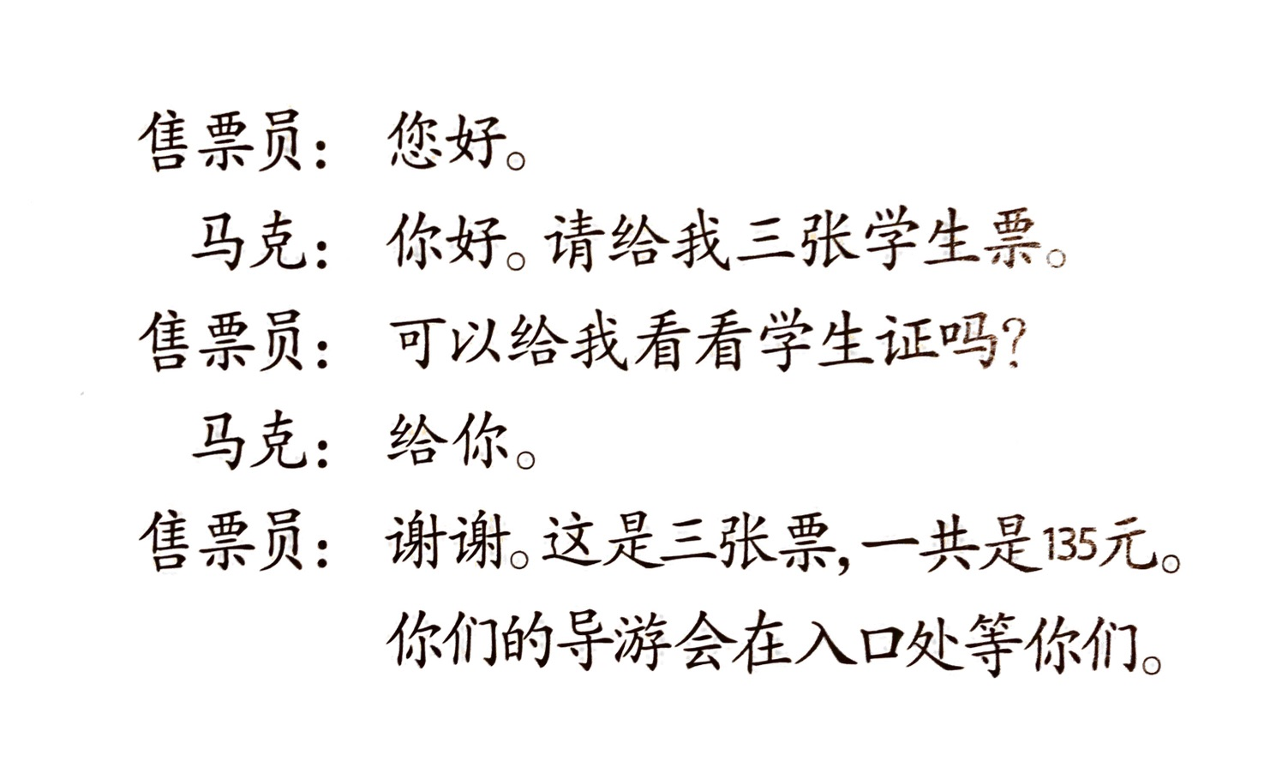

Slide 8
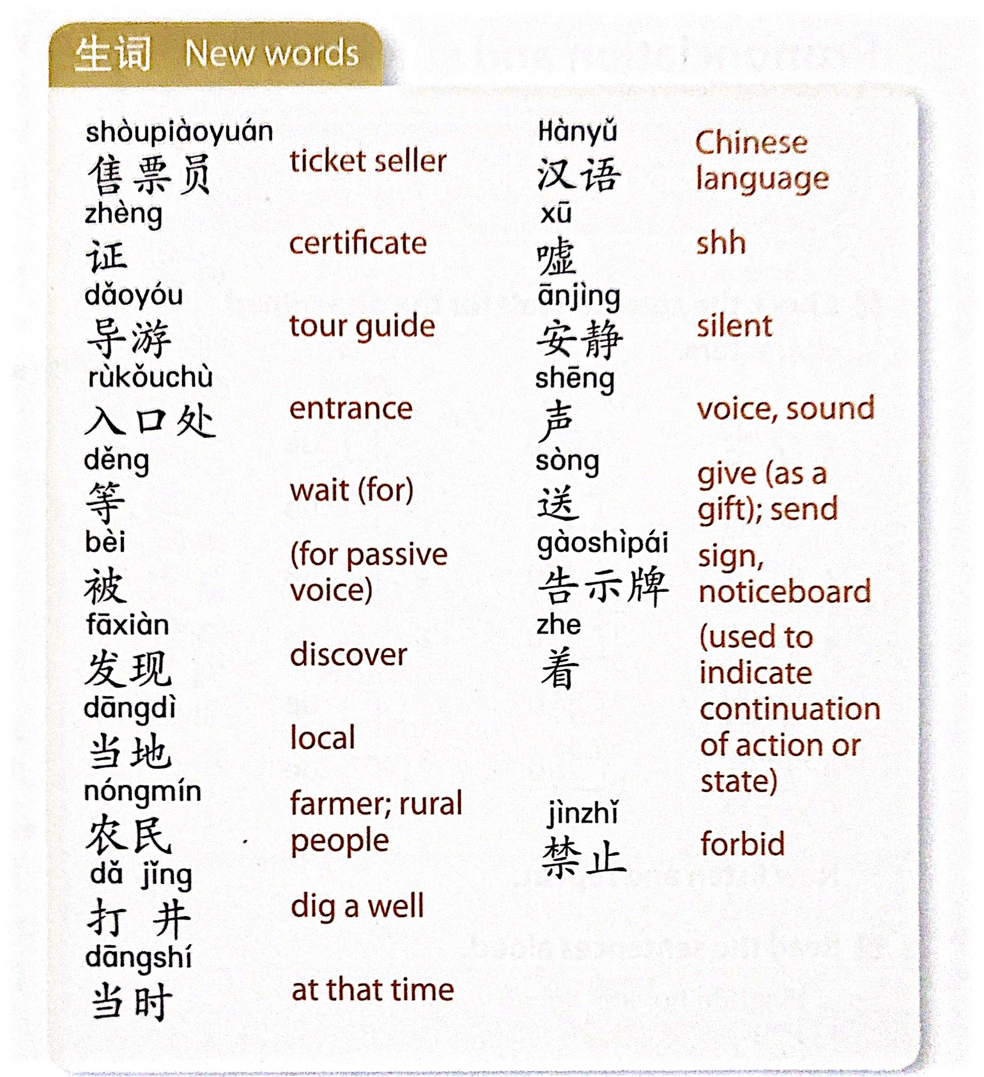

Slide 9

作业
In addition to the usual routine (reading notes and general revision) here is the listening file for the second part of the trip to the Terracotta Army : 兵马俑. Listen to the first part again (where they’re buying tickets) and the first half of the next bit – up to where they start saying that a Terracotta soldier resembles their teacher!。
Don’t worry about the last part of the dialogue – we’ll do it after half term.
Also, if you haven’t done so already, don’t forget to read through the text of the listening about the pet-friendly hotels (page 11 below)
No lesson next week – and then it’s half term, so see you on the 24th

Slide 10
More hotels in China prepare to become pet-friendly
中国会有更多宠物友好酒店
在中国，能带宠物一起住的酒店非常少，常常很远，也有一点贵。
虽然很多人喜欢带宠物去旅游，也想和宠物一起住酒店，但是不少酒店还是不希望宠物来。
花间堂酒店从2009年就开始接受宠物。2021年10月，他们和一个宠物公司合作，想在3年里开100家新的酒店，让更多的人们可以和宠物一起旅游。

Slide 11
https://www.youtube.com/watch?v=jWOHI83vXmM

