Slide 1
Mandarin 10月21号
如果

Slide 2
让我们复习一下 （Revision corner)
The seasons
Radicals
Writing a sentence – I’m not Chinese. I’m British. I live in Britain. My Chinese is not so good. My friend speaks Chinese very well. Next year he wants to go travelling in Britain.
他明年要去英国旅游
Speaking: sentence patterns https://www.youtube.com/watch?v=Zrj1yyjEnrQ

Slide 3
‘When’ and ‘after’
Over Christmas
after dinner
after work
After getting off the train he looks for a taxi
When he takes the train he usually reads a book
When they went to London they didn't go to see a film
After breakfast I want to prepare for the exam

Slide 4
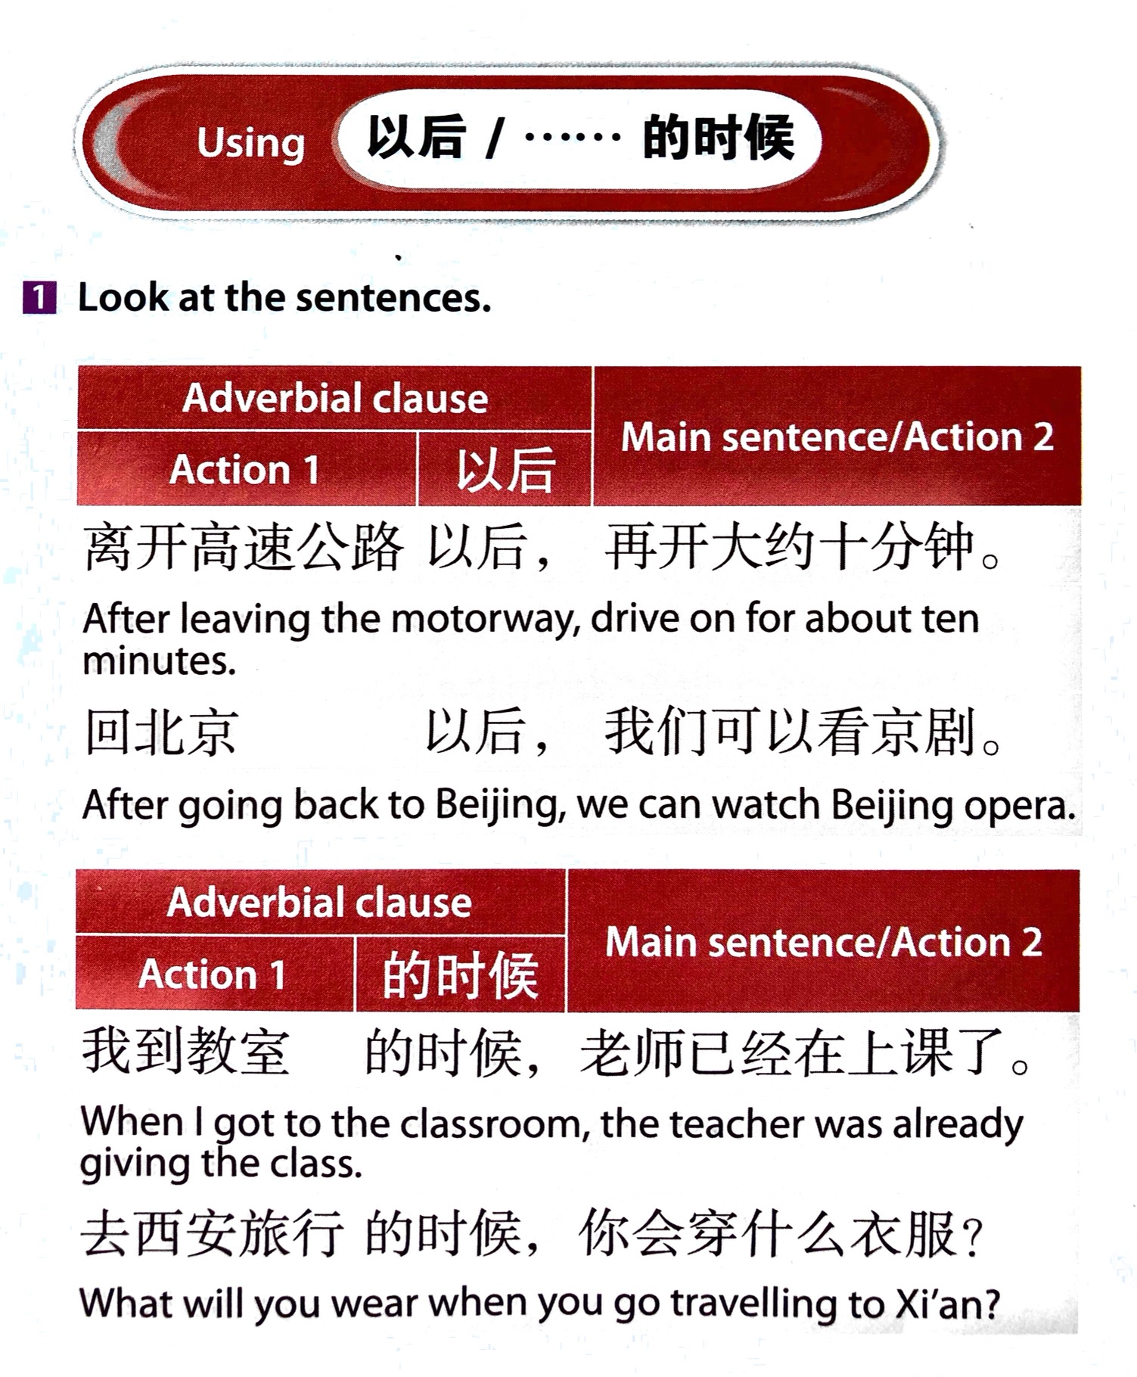

Slide 5
Answers to last homework
我们去她家的时候，她正在做饭
放学以后，我要复习准备考试
你去西安的时候，会穿什么衣服？
放学以后我们会去看电影
暑假的时候你喜欢做什么？

Slide 6
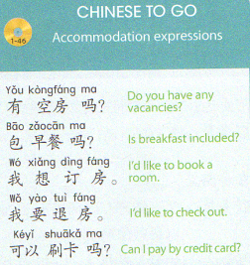

Slide 7
作业
Revise the notes – including the translation exercise on page 3 above
If the listening file comes through successfully, listen repeatedly to the listening
File on page 8 below
Get as much as you can from it using just the sound file and vocab glossary before
Looking at the tapescript.
I’m afraid if the tapescript doesn’t play on your computer (ppt in slideshow mode)
You’ll have to rely on the tapescript (see pages 11 and 12 below)

Slide 8
作业：
听力练习：Say the sentences aloud
2. 写句子: Write three sentences about the position of three objects you can see in the picture.

Slide 9
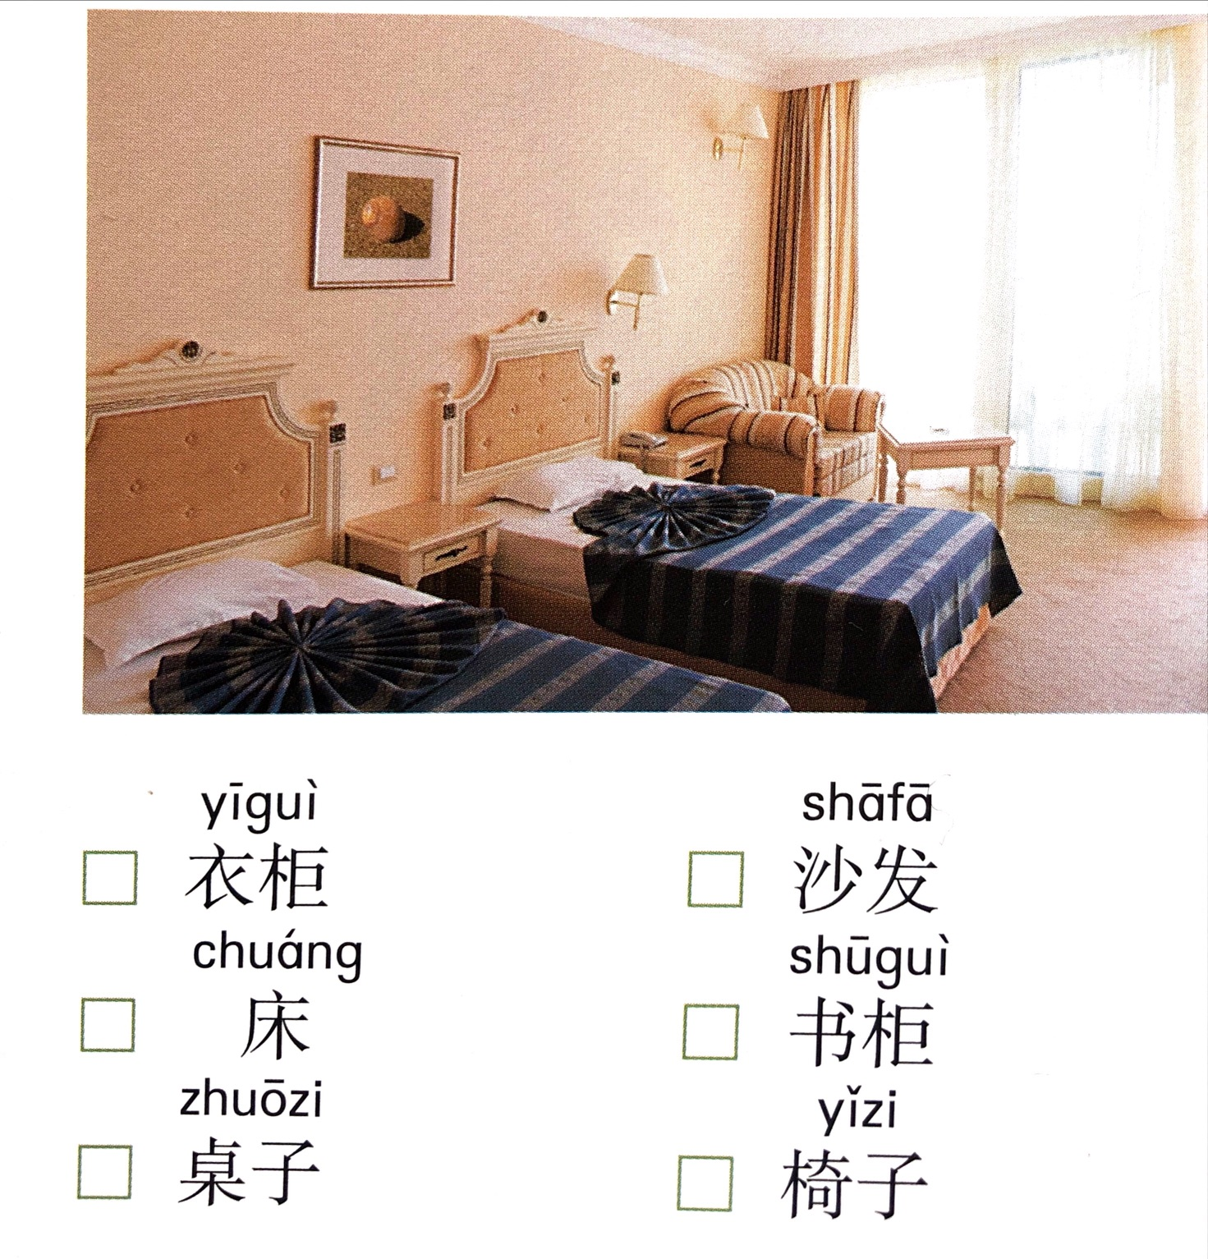

Slide 10
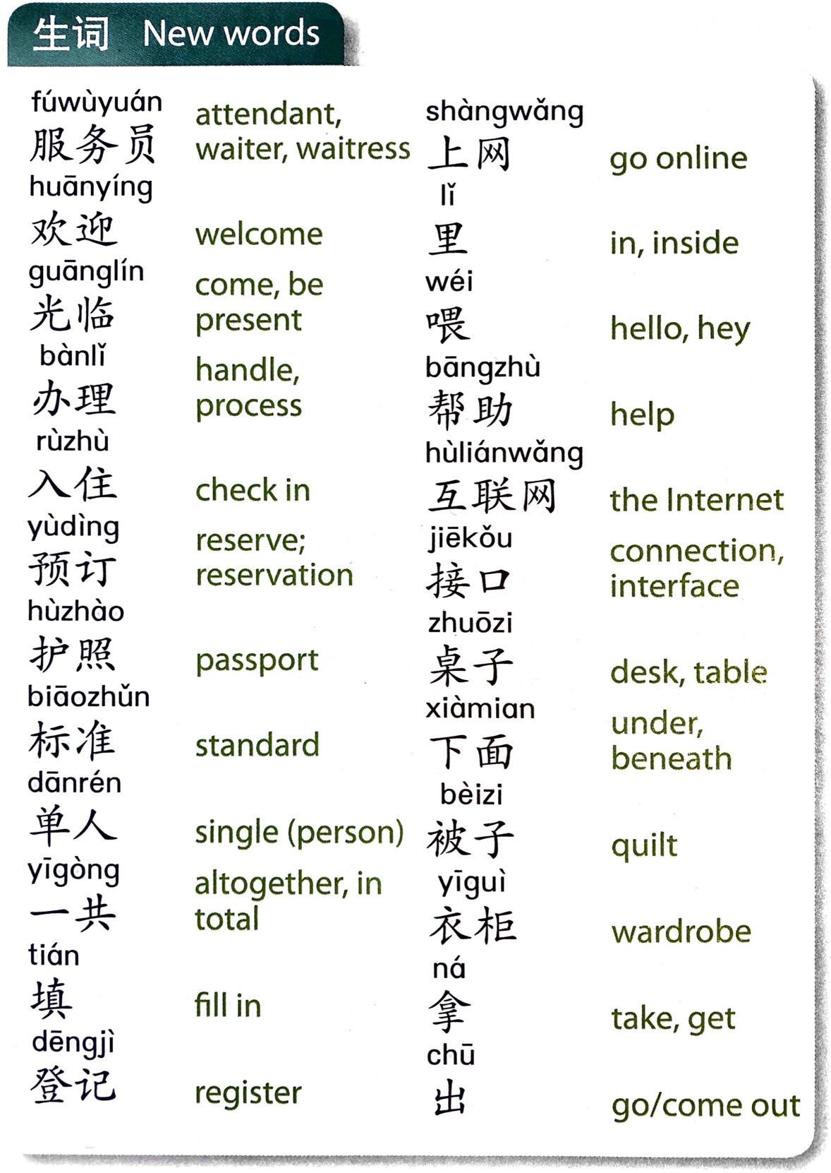

Slide 11
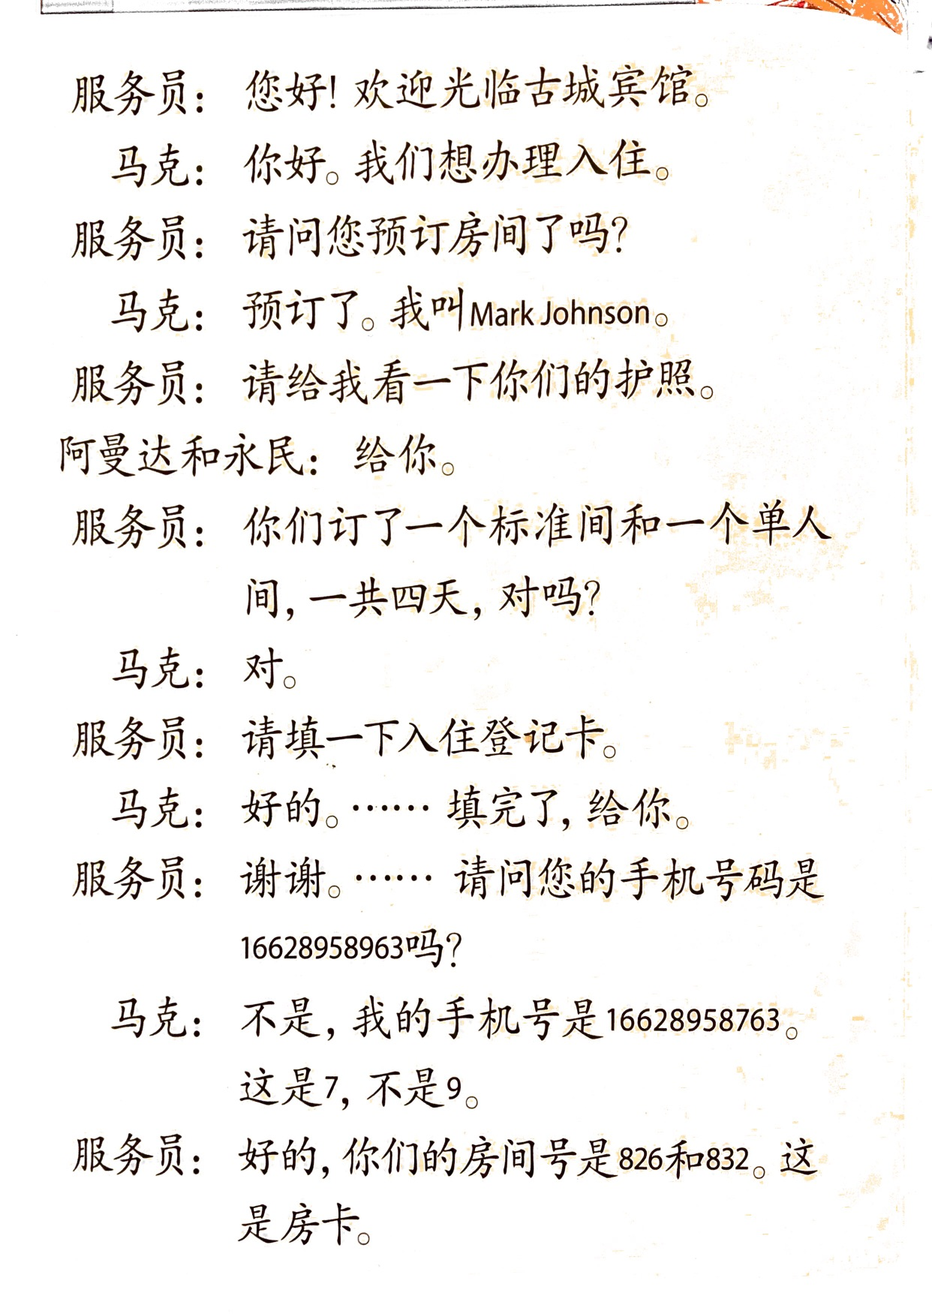

Slide 12
